Slide 1
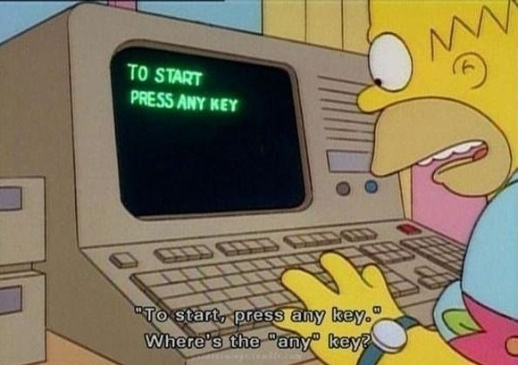
Comp 2071 - Data Structures Lab 4 – Lists: Card Game
Group 5: Team Code Monkeys William Lawrence – ADT, Presentation Tom – Game logic, bug testing Cliff – GUI, presentation Artur – Write up, ADT, javadocs
Notes:
1
Comp 2071 - Lab 1 - Group 1

Slide 2

ADT
Doubly Linked List
Internal Node class to hold next node, last node, and data
Had to handle all edge cases
All functions of ListInterface
Wrote tests
2

Slide 3

Application
GUI using JFrame and Canvas
Basic mouse listener for clicks
Draws your and opponents cards, as well as deck
Dynamically draws cards to maintain visibility
Simple game of go fish
First person to get rid of all cards wins
Not enough time to design a smart AI
Hierarchy of objects to represent game state
3

Slide 4

Issues and Solutions
Cliff didn’t pay attention to testing code, eventually led to bugs
Will forgot some edge cases
Artur learned how to integrate a GUI and a game
Tom had to keep track of a complex game state
4

Slide 5
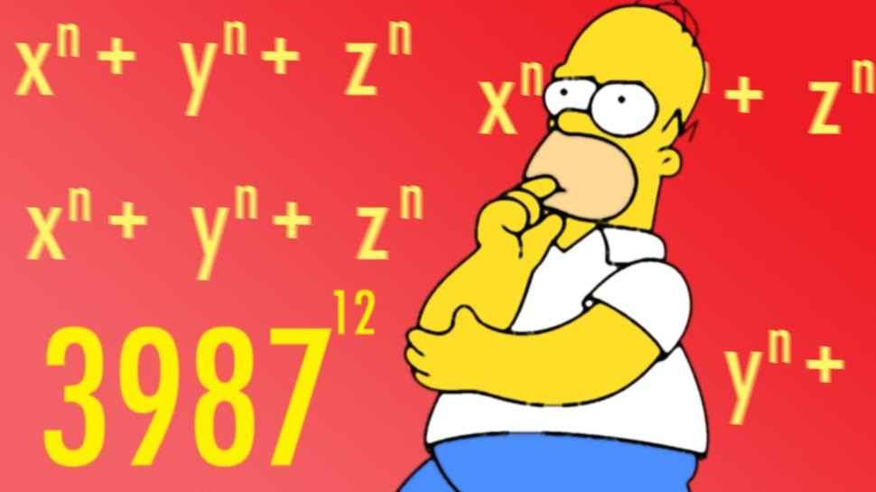
Take-aways
Will learned how to make a doubly linked list
Tom learned the multiplier doesnt matter because it doesnt change the amount of work done
Artur learned how to step back and look at the bigger picture when fixing a bug
Cliff learned how to organize a hierarchy of objects
5

